Slide 1
Introduction to Information Retrieval
Lecture 2
Vector Space Model
Slides source:
http://www.stanford.edu/class/cs276/cs276-2008-syllabus.html

Slide 2
Agenda
Scoring documents
Term frequency
Collection statistics
Weighting schemes
Vector space scoring

Slide 3
Ranked retrieval
Thus far, our queries have all been Boolean.
  Documents either match or don’t (0/1).
Good for expert users with precise understanding of their needs and the collection.
Also good for applications: Applications can easily consume 1000s of results.
  Not good for the majority of users.
  Most users incapable of writing Boolean queries (or they are, but they think it’s too much work).
Most users don’t want to wade through 1000s of results.
  This is particularly true of web search.

Slide 4
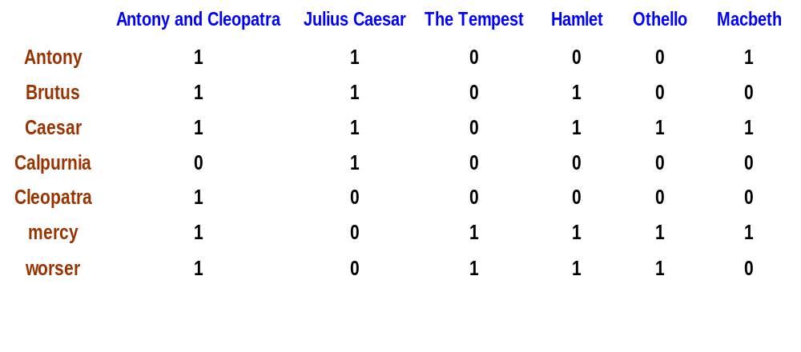
Do you remember how to use it?
1 if play contains word, 0 otherwise
Brutus AND Caesar but NOT Calpurnia

Slide 5
Incidence vectors
So we have a 0/1 vector for each term.
To answer query: take the vectors for Brutus, Caesar and Calpurnia (complemented) ➔ bitwise AND.
110100 AND 110111 AND 101111 = 100100.
Antony and Cleopatra
Hamlet

Slide 6
Problem with Boolean search: feast or famine
Boolean queries often result in either too few (=0) or too many (1000s) results.
It takes skill to come up with a query that produces a manageable number of hits.
With a ranked list of documents it does not matter how large the retrieved set is.

Slide 7
Scoring as the basis of ranked retrieval
We wish to return in order the documents most likely to be useful to the searcher
How can we rank-order the documents in the collection with respect to a query?
Assign a score – say in [0, 1] – to each document
This score measures how well document and query “match”.

Slide 8
Query-document matching scores
We need a way of assigning a score to a query/document pair
Let’s start with a one-term query
If the query term does not occur in the document: score should be 0
The more frequent the query term in the document, the higher the score (should be)
We will look at a number of alternatives for this.

Slide 9
Take 1: Jaccard coefficient
A commonly used measure of overlap of two sets A and B
jaccard(A,B) = |A ∩ B| / |A ∪ B|
jaccard(A,A) = 1
jaccard(A,B) = 0 if A ∩ B = 0
A and B don’t have to be the same size.
Always assigns a number between 0 and 1.

Slide 10
Jaccard coefficient: Scoring example
What is the query-document match score that the Jaccard coefficient computes for each of the two documents below?
Query: ides of march
Document 1: caesar died in march
  (1/6)
Document 2: the long march
  (1/5)

Slide 11
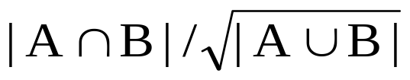
Issues with Jaccard for scoring
It doesn’t consider term frequency (how many times a term occurs in a document)
Rare terms in a collection are more informative than frequent terms. Jaccard doesn’t consider this information
We need a more sophisticated way of normalizing for length
we’ll use
. . . instead of |A ∩ B|/|A ∪ B| for length normalization.

Slide 12

Recall (Lecture 1): Binary term-document incidence matrix
Each document is represented by a binary vector ∈ {0,1}^{|V|}

Slide 13
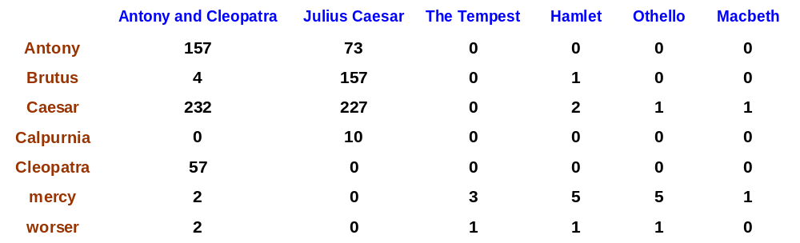
Term-document count matrices
Consider the number of occurrences of a term in a document:
  Each document is a count vector in ℕ^{v}: a column below

Slide 14
Bag of words model
Vector representation doesn’t consider the ordering of words in a document
John is quicker than Mary and Mary is quicker than John have the same vectors
This is called the bag of words model.
In a sense, this is a step back: The positional index was able to distinguish these two documents.

Slide 15
Term frequency tf
The term frequency tf_{t,d} of term t in document d is defined as the number of times that t occurs in d.
How to use tf when computing query-document match scores?

Slide 16
Term frequency tf, cont.
Raw term frequency is not what we want:
  A document with 10 occurrences of the term is more relevant than a document with one occurrence of the term.
  But not 10 times more relevant!
Relevance does not increase proportionally with term frequency
  look at term “Caesar” in two vectors: “Julius Caesar” and “Othello”, at slide 11

Slide 17
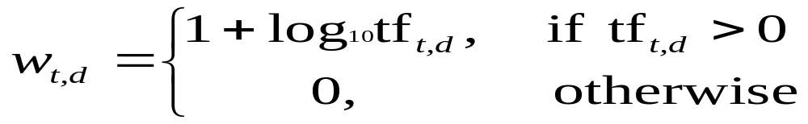

Log-frequency weighting
The log frequency weight of term t in d is
0 → 0, 1 → 1, 2 → 1.3, 10 → 2, 1000 → 4, etc.
Score for a document-query pair: sum over terms t in both q and d:
score
The score is 0 if none of the query terms is present in the document.

Slide 18
Document frequency
Rare terms are more informative than frequent terms
  Recall stop words
Consider a term in the query that is rare in the collection (e.g., acrocentric)
A document containing this term is very likely to be relevant to the query acrocentric
→ We want a high weight for rare terms like acrocentric.

Slide 19
Document frequency, cont.
Consider a query term that is frequent in the collection (e.g., high, increase, line)
A document containing such a term is more likely to be relevant than a document that doesn’t, but it’s not a sure indicator of relevance.

Slide 20
Document frequency, cont.
→ For frequent terms, we want positive weights for words like high, increase, and line, but lower weights than for rare terms.
We will use document frequency (df) to capture this in the score.
df (≤ N) is the number of documents that contain the term

Slide 21
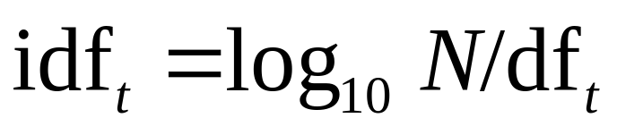
idf weight
df_{t} is the document frequency of t: the number of documents that contain t
  df is a measure of the informativeness of t
We define the idf (inverse document frequency) of t by
  We use log N/df_{t} instead of N/df_{t} to “dampen” the effect of idf.
Will turn out the base of the log is immaterial.

Slide 22
idf example, suppose N= 1 million
term | df_{t} | idf_{t}
calpurnia | 1 | 6
animal | 100 | 4
sunday | 1,000 | 3
fly | 10,000 | 2
under | 100,000 | 1
the | 1,000,000 | 0
There is one idf value for each term t in a collection.

Slide 23
Collection vs. Document frequency
The collection frequency of t is the number of occurrences of t in the collection, counting multiple occurrences.
Example:
Which word is a better search term (and should get a higher weight)?
Word | Collection frequency | Document frequency
insurance | 10440 | 3997
try | 10422 | 8760

Slide 24
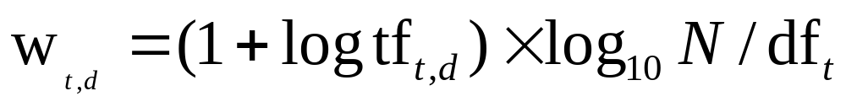
tf-idf weighting
The tf-idf weight of a term is the product of its tf weight and its idf weight.
Best known weighting scheme in information retrieval
Note: the “-” in tf-idf is a hyphen, not a minus sign!
Alternative names: tf.idf, tf x idf
Increases with the number of occurrences within a document
Increases with the rarity of the term in the collection

Slide 25

Binary → count → weight matrix
Each document is now represented by a real-valued vector of tf-idf weights ∈ R^{|V|}

Slide 26
Documents as vectors
So we have a |V|-dimensional vector space
Terms are axes of the space
Documents are points or vectors in this space
Very high-dimensional: hundreds of millions of dimensions when you apply this to a web search engine
This is a very sparse vector - most entries are zero.

Slide 27
Queries as vectors
Key idea 1: Do the same for queries: represent them as vectors in the space
Key idea 2: Rank documents according to their proximity to the query in this space
proximity = similarity of vectors
proximity ≈ inverse of distance
Recall: We do this because we want to get away from the you’re-either-in-or-out Boolean model.
Instead: rank more relevant documents higher than less relevant documents

Slide 28

Formalizing vector space proximity
First cut: distance between two points
  ( = distance between the end points of the two vectors)
Euclidean distance?
. . . bad idea . . .
. . . because Euclidean distance is large for vectors of different lengths.

Slide 29

Why distance is a bad idea
The Euclidean distance between q
and d₂ is large even though the
distribution of terms in the query q and the distribution of
terms in the document d₂ are
very similar.

Slide 30
Use angle instead of distance
Thought experiment: take a document d and append it to itself. Call this document d′.
“Semantically” d and d′ have the same content
The Euclidean distance between the two documents can be quite large
The angle between the two documents is 0, corresponding to maximal similarity.
Key idea: Rank documents according to angle with query.

Slide 31



From angles to cosines
The following two notions are equivalent.
  Rank documents in decreasing order of the angle between query and document
  Rank documents in increasing order of cosine(query,document)
Cosine is a monotonically decreasing function for the interval [0º, 180º]
θ | 0º | 30º | 45º | 60º | 90º | 180º | 270º
cos θ | 1 |  |  |  | 0 | -1 | 0

Slide 32
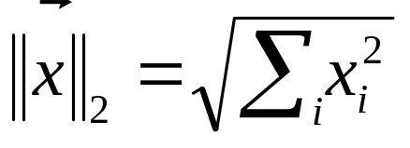
Length normalization
A vector can be (length-) normalized by dividing each of its components by its length – for this we use the L₂ norm:
Dividing a vector by its L₂ norm makes it a unit (length) vector
Effect on the two documents d and d′ (d appended to itself) from earlier slide: they have identical vectors after length-normalization.

Slide 33

cosine(query,document)
Dot product
Unit vectors
q_{i} is the tf-idf weight of term i in the query
d_{i} is the tf-idf weight of term i in the document
cos(q,d) is the cosine similarity of q and d … or,
equivalently, the cosine of the angle between q and d.

Slide 34
Cosine similarity amongst 3 documents, using log freq. weighting vectors
How similar are
the novels
SaS: Sense and
Sensibility
PaP: Pride and
Prejudice, and
WH: Wuthering
Heights?
term | SaS | PaP | WH
affection | 115 | 58 | 20
jealous | 10 | 7 | 11
gossip | 2 | 0 | 6
wuthering | 0 | 0 | 38
Term frequencies (counts)

Slide 35
3 documents example contd.
Log frequency weighting
After normalization
1+log 115
3.06/sqrt(3.06^2+2^2+1.3^2)
term | SaS | PaP | WH
affection | 3.06 | 2.76 | 2.30
jealous | 2.00 | 1.85 | 2.04
gossip | 1.30 | 0 | 1.78
wuthering | 0 | 0 | 2.58
term | SaS | PaP | WH
affection | 0.789 | 0.832 | 0.524
jealous | 0.515 | 0.555 | 0.465
gossip | 0.335 | 0 | 0.405
wuthering | 0 | 0 | 0.588
cos(SaS,PaP) ≈
0.789 ∗ 0.832 + 0.515 ∗ 0.555 + 0.335 ∗ 0.0 + 0.0 ∗ 0.0
≈ 0.94
cos(SaS,WH) ≈ 0.79
cos(PaP,WH) ≈ 0.69
see calcs.xls for detailed calculations
Why do we have cos(SaS,PaP) > cos(SaS,WH)?

Slide 36
Cosine similarity amongst 3 documents, using tf-idf vectors, given 30 documents
How similar are
the novels
SaS: Sense and
Sensibility
PaP: Pride and
Prejudice, and
WH: Wuthering
Heights?
term | SaS | PaP | WH
affection | 115 | 58 | 20
jealous | 10 | 7 | 11
gossip | 2 | 0 | 6
wuthering | 0 | 0 | 38
Term frequencies (counts)
Number of documents = 30

Slide 37
3 documents example, cont.
Log frequency weighting
idf weighting
1+log 115
log 30/5
term | SaS | PaP | WH
affection | 3.06 | 2.76 | 2.30
jealous | 2.00 | 1.85 | 2.04
gossip | 1.30 | 0 | 1.78
wuthering | 0 | 0 | 2.58
term | df | idf
affection | 5 | 0.78
jealous | 6 | 0.70
gossip | 3 | 1.00
wuthering | 2 | 1.18

Slide 38
3 documents example, cont.
Tf-idf weighting
After normalization
3.06*0.78
2.38/sqrt(2.38^2+1.4^2+1.3^2)
term | SaS | PaP | WH
affection | 2.38 | 2.15 | 1.79
jealous | 1.40 | 1.29 | 1.43
gossip | 1.30 | 0.00 | 1.78
wuthering | 0.00 | 0.00 | 3.03
term | SaS | PaP | WH
affection | 0.78 | 0.86 | 0.43
jealous | 0.46 | 0.51 | 0.34
gossip | 0.43 | 0.00 | 0.42
wuthering | 0.00 | 0.00 | 0.72
cos(SaS,PaP) ≈
0.78 ∗ 0.86 + 0.46 ∗ 0.51 + 0.43 ∗ 0 + 0 ∗ 0
≈ 0.9
cos(SaS,WH) ≈ 0.67
cos(PaP,WH) ≈ 0.54
see calcs.xls for detailed calculations

Slide 39

Computing cosine scores

Slide 40

tf-idf weighting has many variants
Columns headed ‘n’ are acronyms for weight schemes.
Why is the base of the log in idf immaterial?

Slide 41
Weighting may differ in queries vs. documents
Many search engines allow for different weightings for queries vs documents
To denote the combination in use in an engine, we use the notation qqq.ddd with the acronyms from the previous table
Example: ltn.lnc means:
Query: logarithmic tf (l in leftmost column), idf (t in second column), no normalization (n)…
Document: logarithmic tf (l), no idf (n) and cosine normalization (c)
Is this a bad idea?

Slide 42
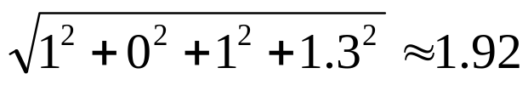
tf-idf example: ltn.lnc
see calcs.xls for detailed calculations
Document: car insurance auto insurance
Query: best car insurance
1+log 1
log X/10000 = 2
1/1.92 = 2
Term | Query |  |  |  |  | Document |  |  |  | Prod
 | tf-raw | tf-wt | df | idf | wt | tf-raw | tf-wt | wt | n’lized
auto | 0 | 0 | 5000 | 2.3 | 0 | 1 | 1 | 1 | 0.52 | 0
best | 1 | 1 | 50000 | 1.3 | 1.3 | 0 | 0 | 0 | 0 | 0
car | 1 | 1 | 10000 | 2.0 | 2.0 | 1 | 1 | 1 | 0.52 | 1.04
insurance | 1 | 1 | 1000 | 3.0 | 3.0 | 2 | 1.3 | 1.3 | 0.68 | 2.03
Exercise: what is N, the number of docs?
Doc length =
Score = 0+0+1.04+2.03 = 3.07

Slide 43
Summary
Vector space model - is an algebraic model for representing text documents as vectors of identifiers, such as, for example, index terms.
A document is represented as a vector. Each dimension corresponds to a separate term. If a term occurs in the document, its value in the vector is non-zero.
  There are several different ways of computing these values (term weights).
  One of the best known schemes is tf-idf weighting.

Slide 44
Summary, cont.
The definition of term depends on the application.
  Typically terms are single words, keywords, or longer phrases.
  The dimensionality of the vector is the number of terms in the corpus .
  Example: If the words are chosen to be the terms, the dimensionality = number of distinct words occurring in the corpus.

Slide 45

Summary, cont.
Relevancy rankings of documents can be calculated by comparing the deviation of angles between each document vector and the original query vector
  the query is represented as same kind of vector as the documents.
In practice, it is easier to calculate the cosine of the angle between the vectors instead of the angle:

Slide 46
Limitations of vector space model
Long documents are poorly represented because they have poor similarity values (a small scalar product and a large dimensionality)
Semantic sensitivity; documents with similar context but different term vocabulary won't be associated, resulting in a "false negative match".
The order in which the terms appear in the document is lost in the vector space representation.

Slide 47
Summary – vector space ranking
Represent the query as a weighted vector (tf-idf)
Represent each document as a weighted vector (tf-idf)
Compute the cosine similarity score for the query vector and each document vector
Rank documents with respect to the query by score
Return the top K (e.g., K = 10) to the user

